Slide 1



PREDICTING FLIGHT DELAYS
Prepared BY-
ISHIKA BIGALA – UIN 650009824
SANJANA RAJESH PISAL – UIN 667084283

Slide 2
TABLE OF CONTENTS
1. Abstract
2. Problem Statement
3. Project Goals
4. Dataset Description
5. Exploratory Data Analysis
6. Statistical Tests And Plots
7. Confusion Matrix And Statistical Analysis
8. Training Performance And Learning Curves
9. Comparative Evaluation Of ML Models
10. Conclusion
11. Recommendations
12. Future Work And References

Slide 3

ABSTRACT
Flight delays significantly impact passenger experiences and airline operations. This project uses a dataset of over 539,000 records to analyze patterns and build predictive models for flight delays. By leveraging machine learning, we aim to identify delay causes and propose actionable insights to mitigate them.

Slide 4

PROBLEM STATEMENT
Flight delays disrupt schedules, increase operational costs, and erode customer satisfaction. With structured historical data, machine learning models can help predict delays, enabling airlines to address root causes and optimize schedules effectively.

Slide 5
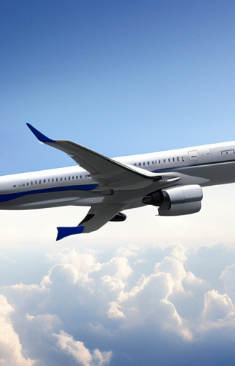
PROJECT GOALS
Perform detailed analysis of the flight delay dataset to uncover key trends.
Develop and compare machine learning models to predict delays accurately.
Offer data-driven recommendations to reduce delays and improve efficiency.

Slide 6
DATASET DESCRIPTION
The dataset contains 539,383 records with 9 features: - Categorical Variables: Airline, AirportFrom, AirportTo.
Numeric Variables: Time, Length, Delay (binary target variable).
Key Statistics: - Average flight duration: 132.2 minutes. - Majority of flights are on time, with delays recorded in ~44.5% of cases.
Preprocessing Steps: -Data Cleaning: Removed inconsistent records that could lead to inaccurate modeling or analysis.
- Feature Engineering: Encoded categorical variables like Airline, AirportFrom, and AirportTo into numeric representations suitable for machine learning models.

Slide 7
DATASET DESCRIPTION
Normalization:
Scaled numeric variables such as Time (departure time) and Length (flight duration) to standardize their ranges, improving model performance and convergence.
Data Splitting:
Partitioned the dataset into training (80%) and testing (20%) subsets to evaluate the models effectively and prevent overfitting.

Slide 8

EXPLORATORY DATA ANALYSIS
Key Findings: 1. Day of Week: Delays are more frequent on specific days, particularly Mondays and Fridays. 2. Airline Performance: Some airlines consistently report higher delays, while others maintain better punctuality. 3. Flight Duration: Longer flights tend to have higher delay probabilities. 4. Departure Times: Peak delays occur during early mornings and late evenings.

Slide 9
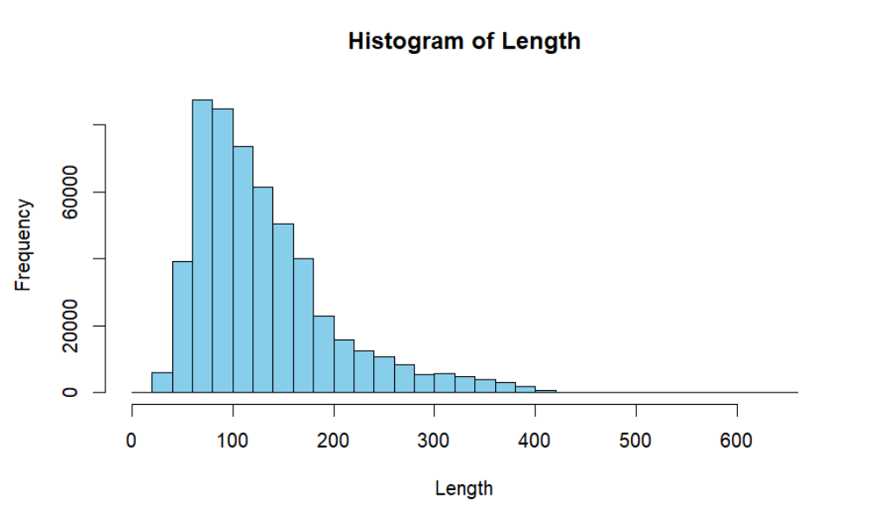
EXPLORATORY DATA ANALYSIS
Visual Insights:
- Histograms depicting delay distributions by departure time.

Slide 10
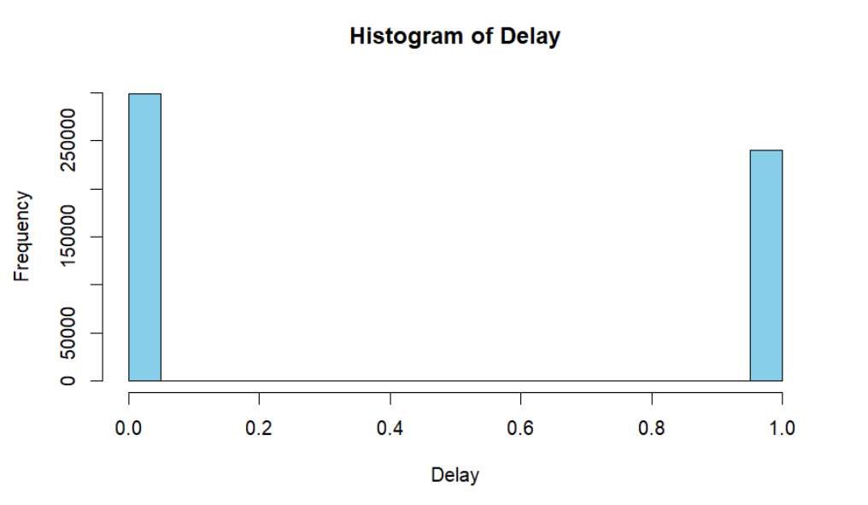
EXPLORATORY DATA ANALYSIS

Slide 11
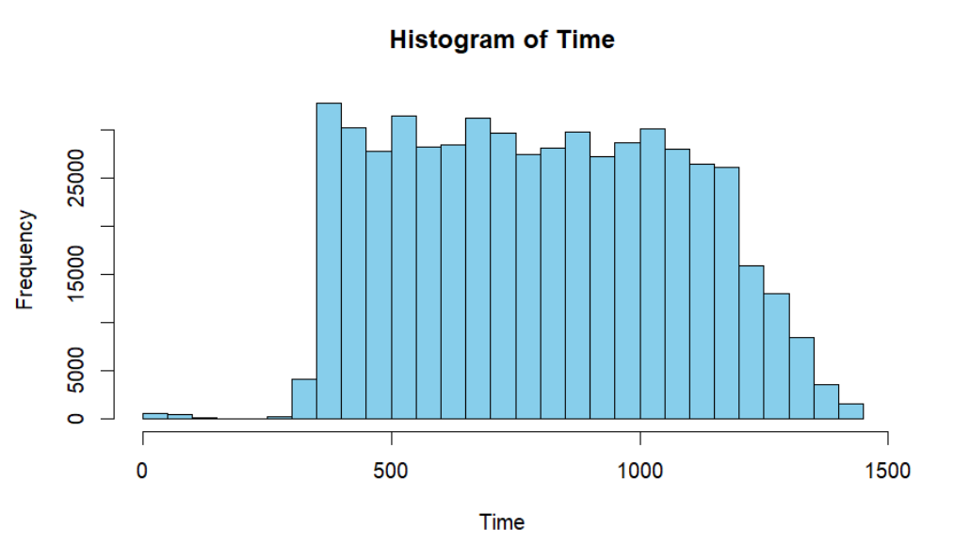
EXPLORATORY DATA ANALYSIS

Slide 12
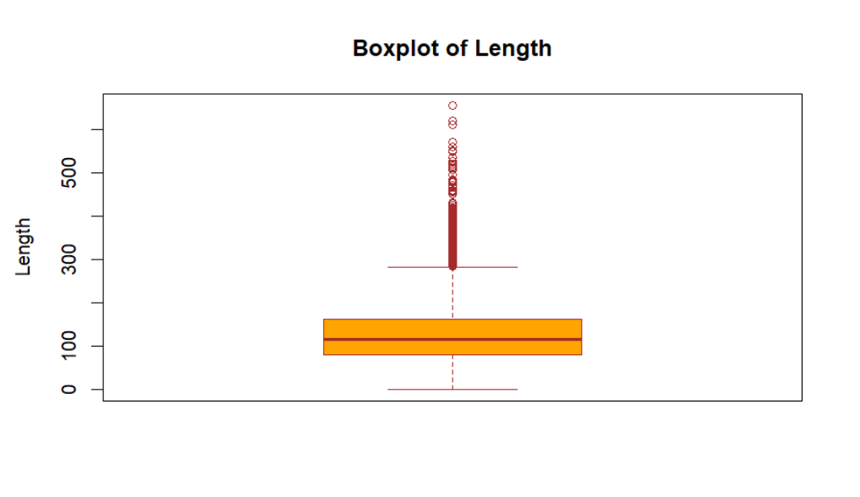
EXPLORATORY DATA ANALYSIS
- Boxplots comparing delays across airlines.

Slide 13
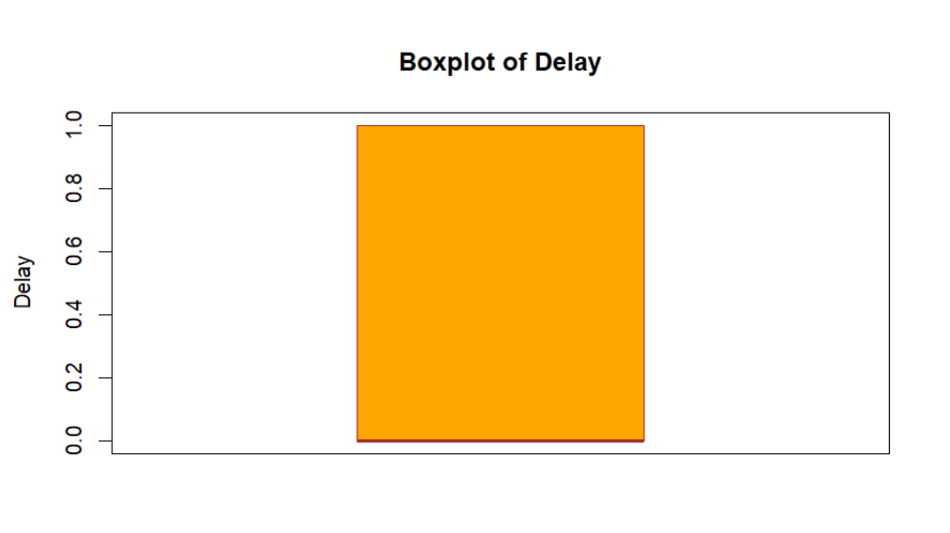
EXPLORATORY DATA ANALYSIS

Slide 14
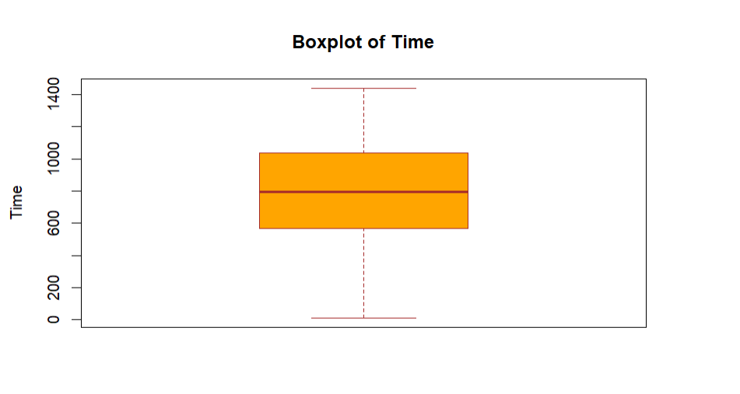
EXPLORATORY DATA ANALYSIS

Slide 15
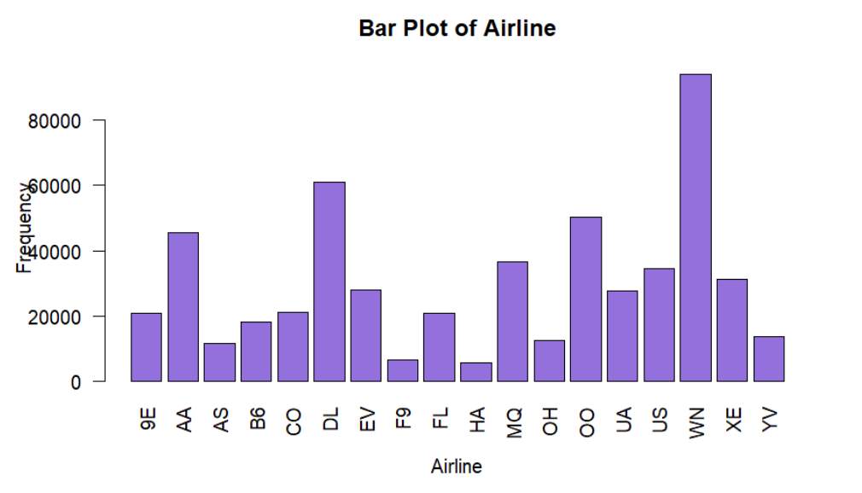
EXPLORATORY DATA ANALYSIS

Slide 16
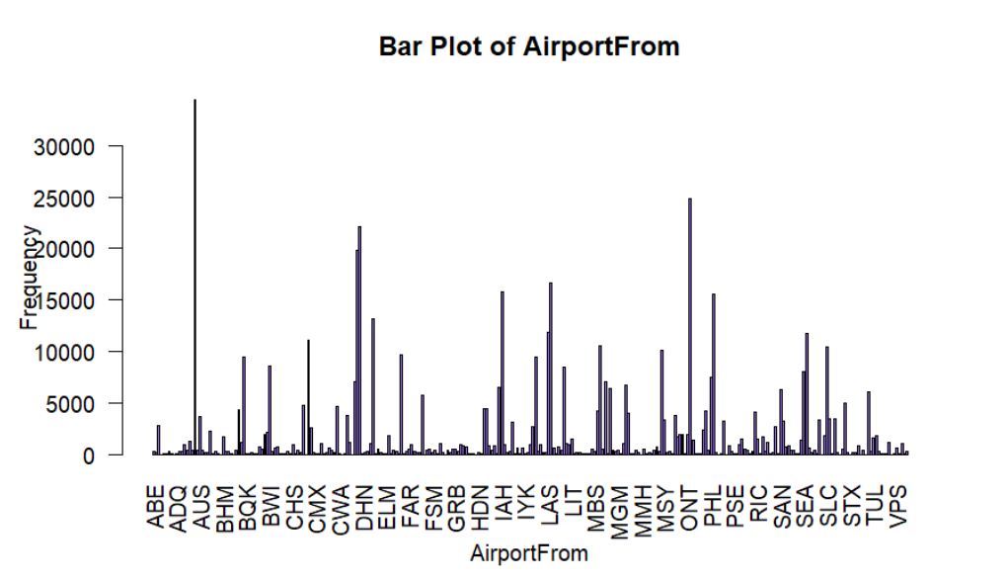
EXPLORATORY DATA ANALYSIS

Slide 17
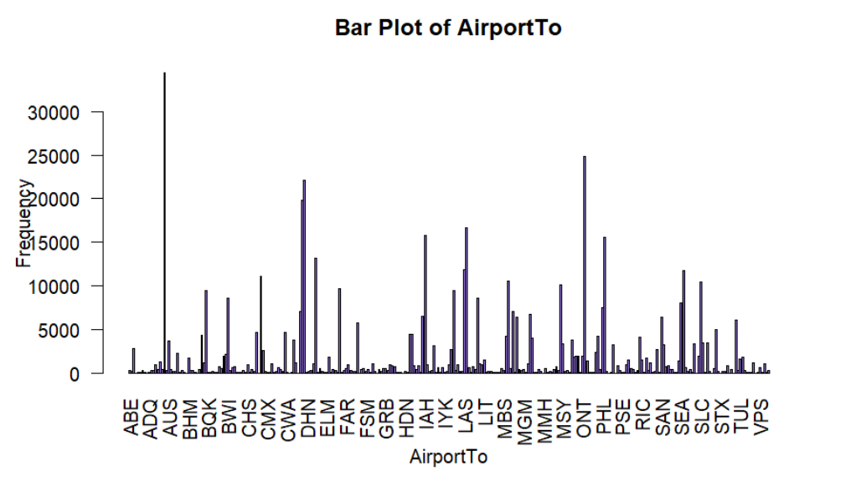
EXPLORATORY DATA ANALYSIS

Slide 18
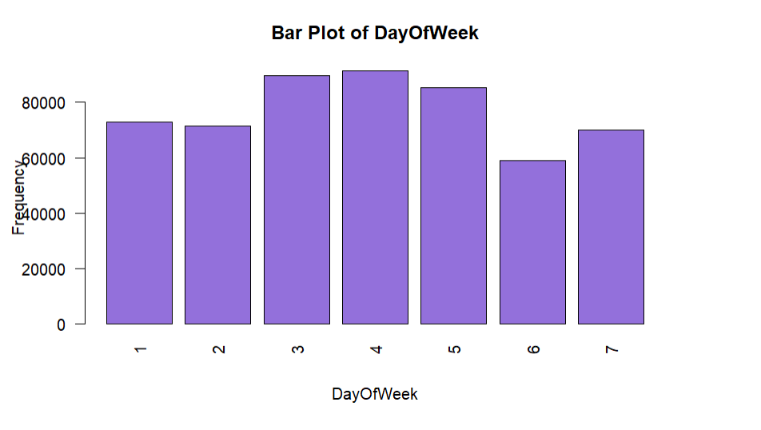
EXPLORATORY DATA ANALYSIS

Slide 19
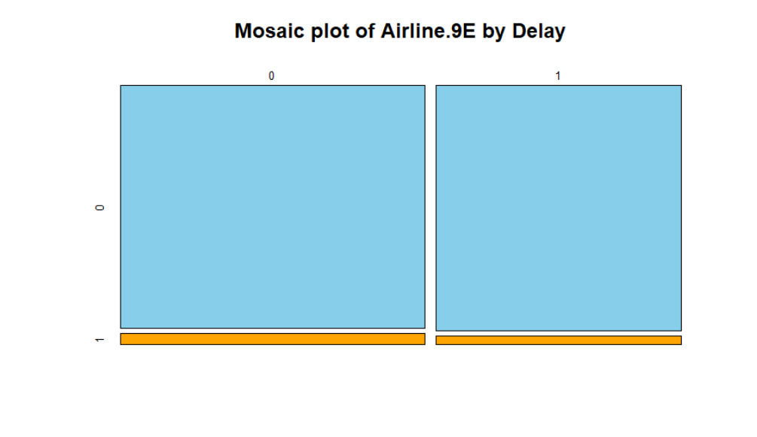
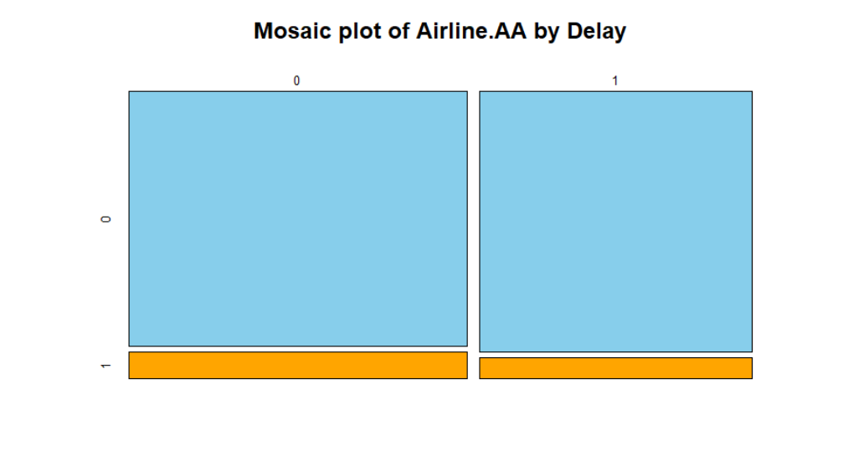
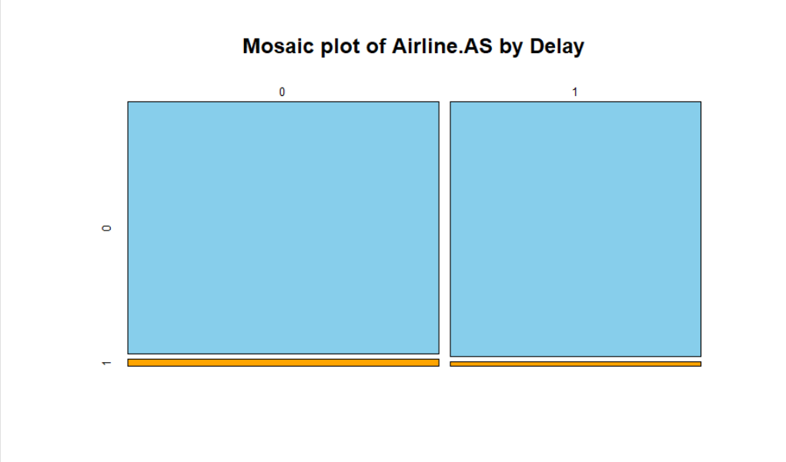
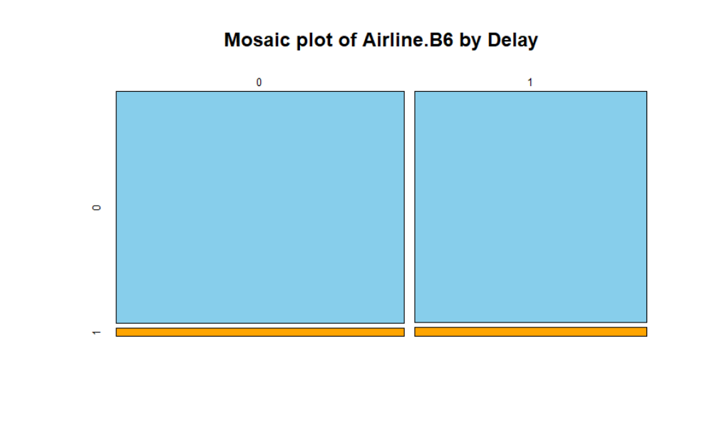
STATISTICAL TESTS AND PLOTS

Slide 20
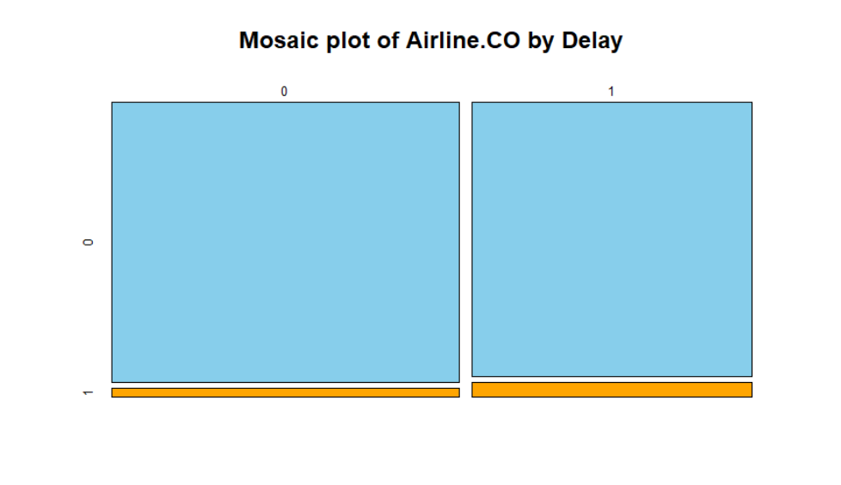
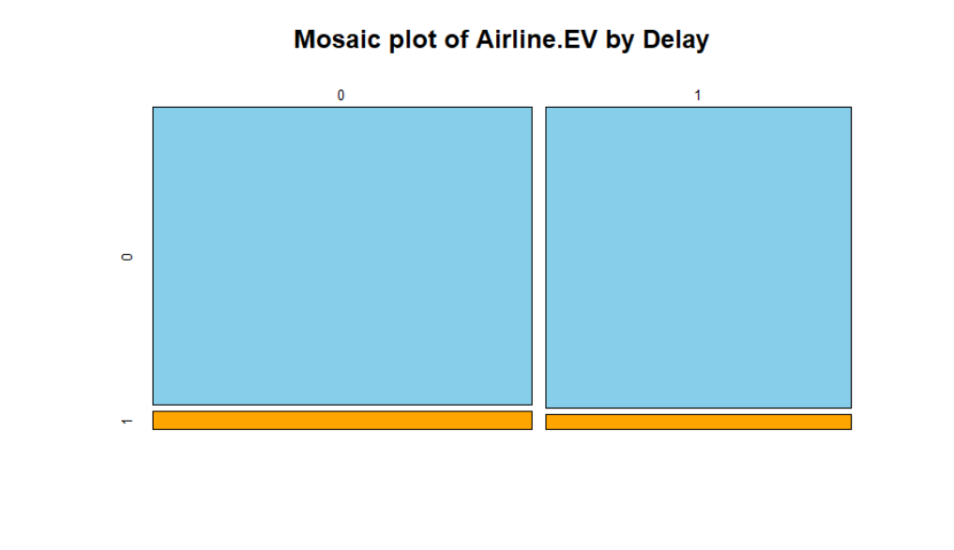
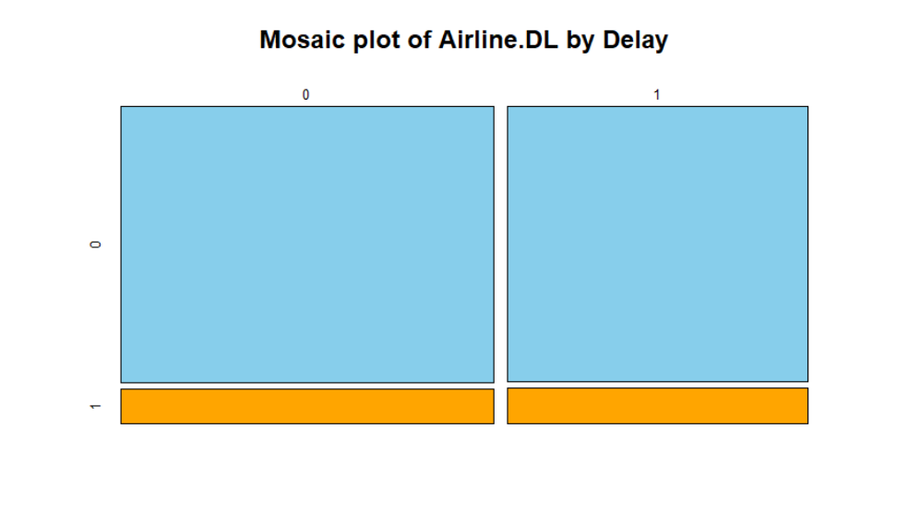
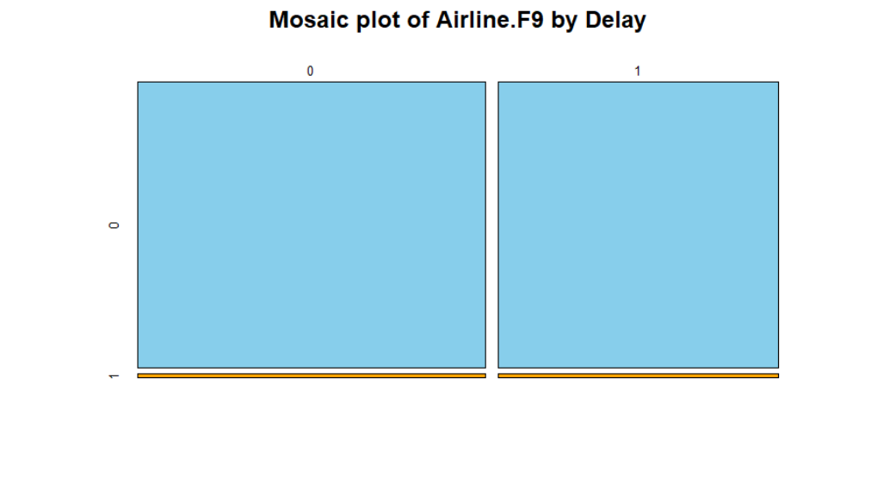
STATISTICAL TESTS AND PLOTS

Slide 21
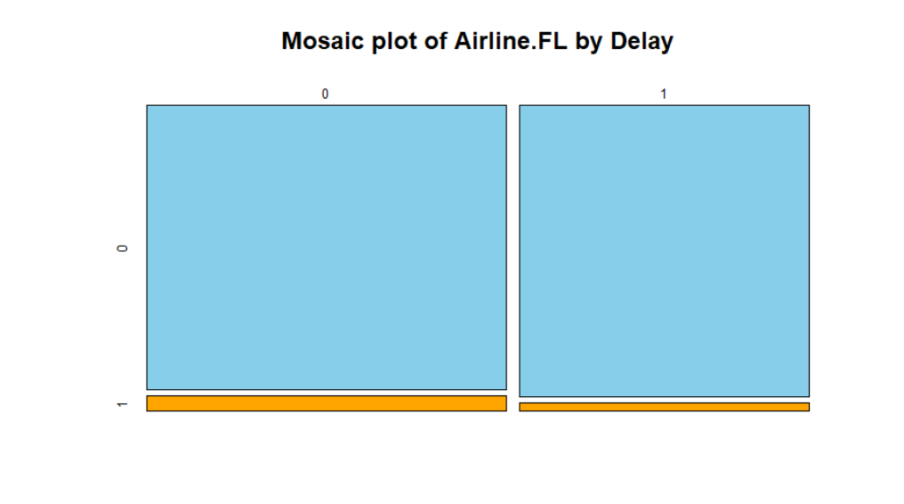
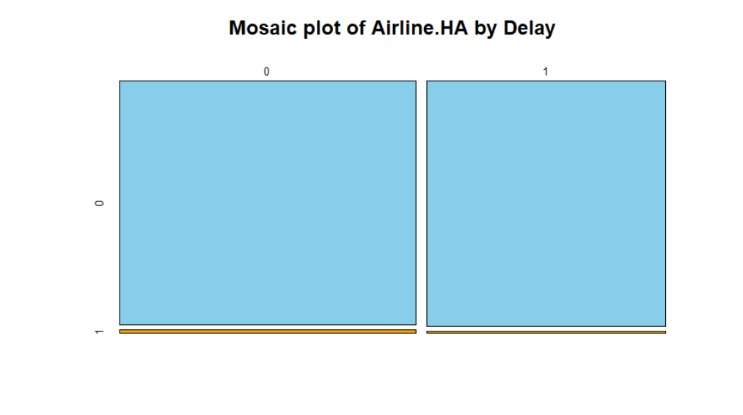
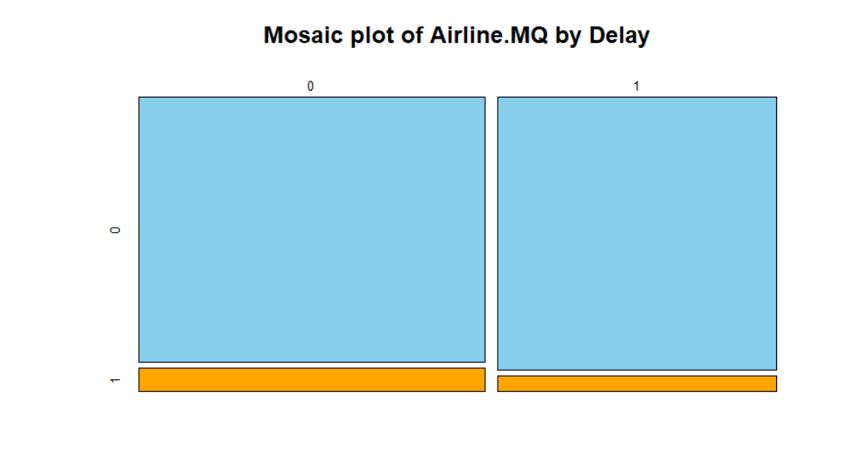
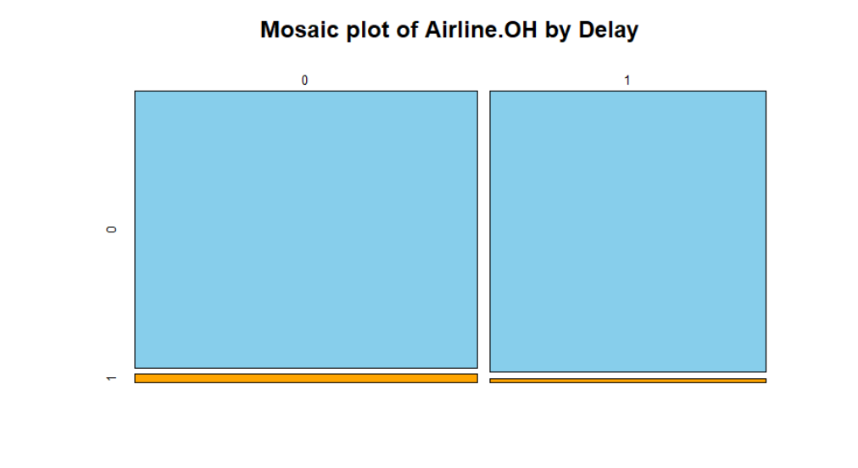
STATISTICAL TESTS AND PLOTS

Slide 22
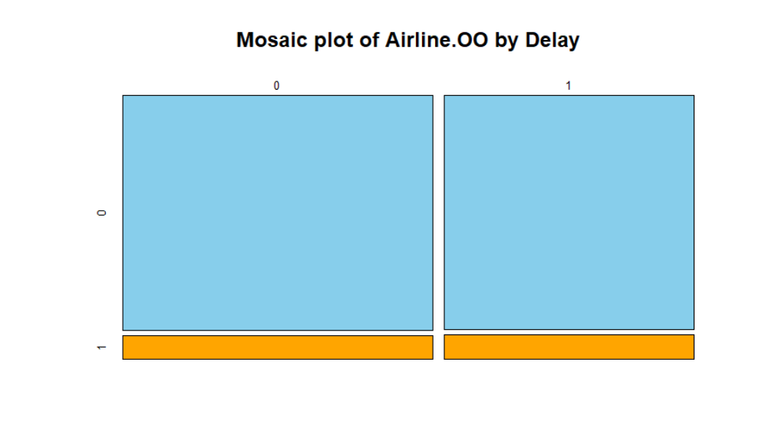

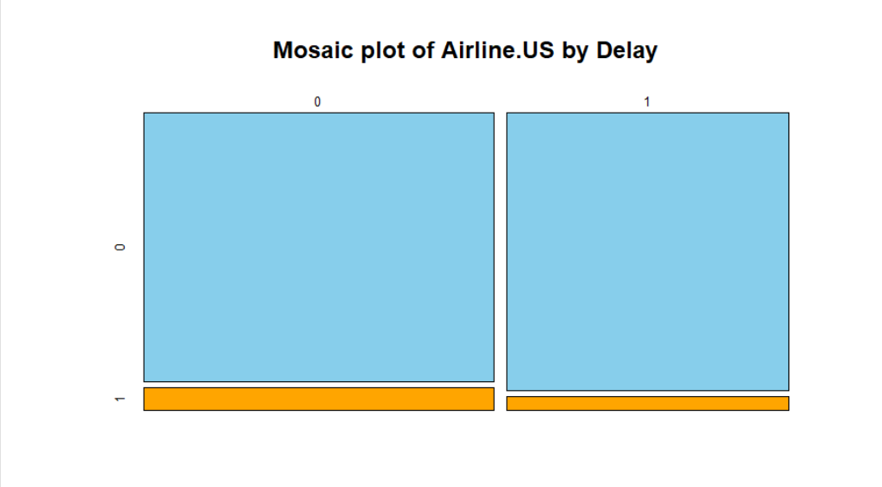
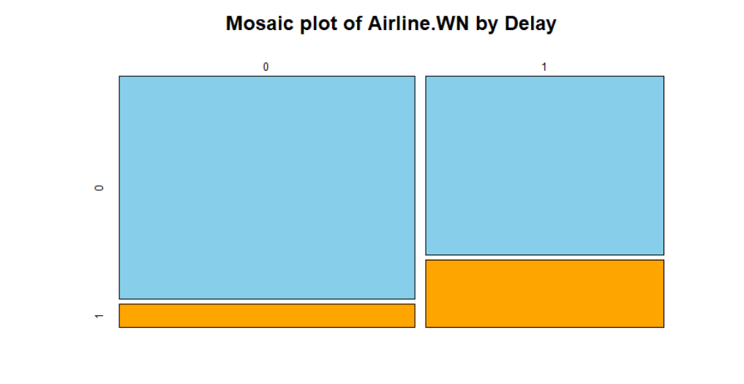
STATISTICAL TESTS AND PLOTS

Slide 23
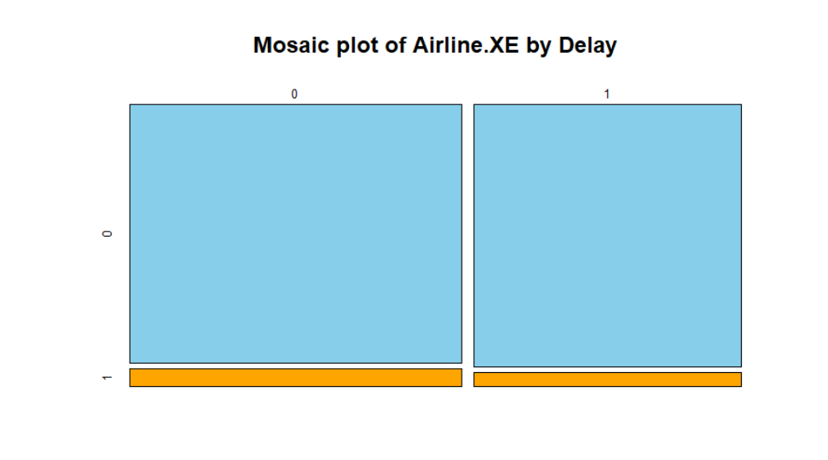
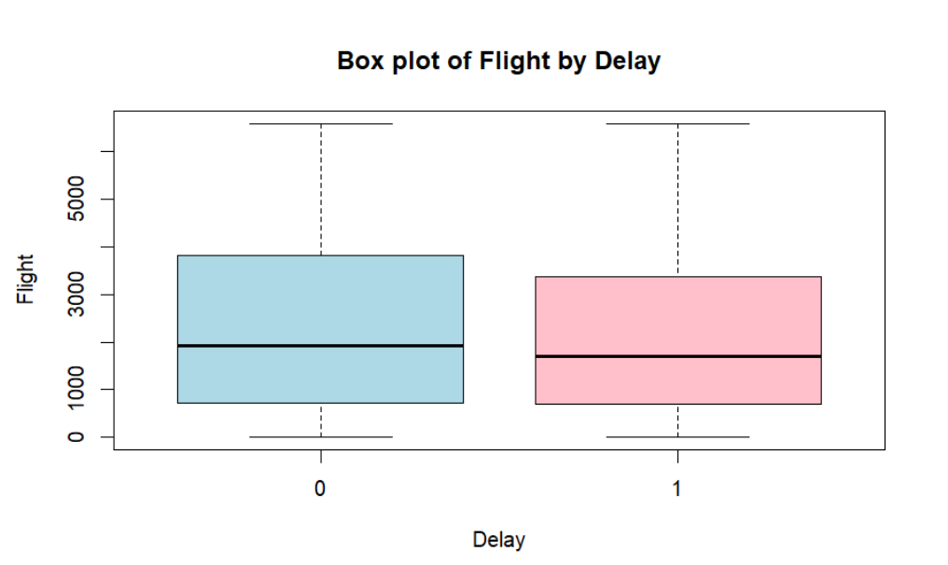
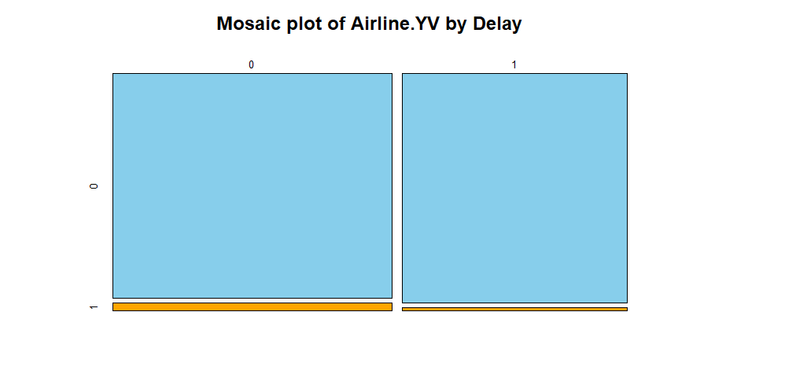
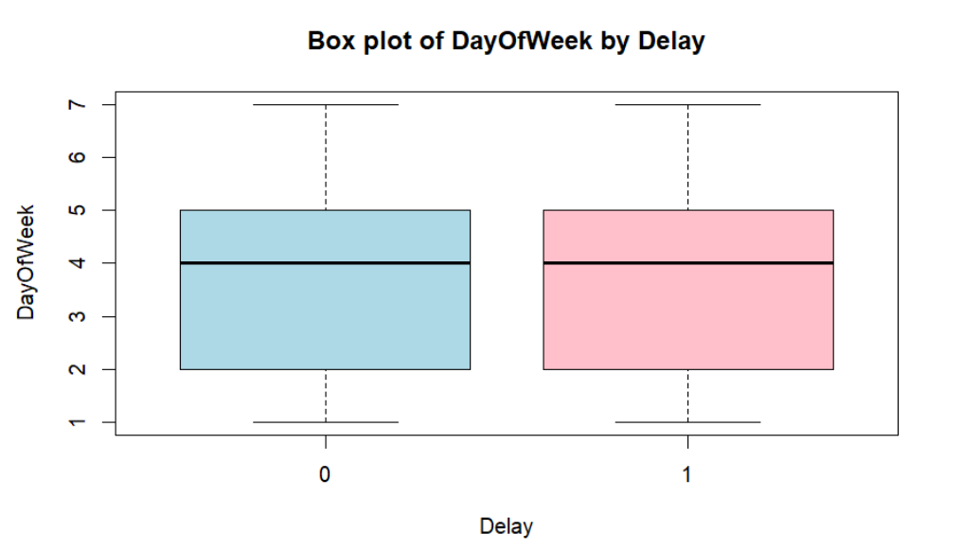
STATISTICAL TESTS AND PLOTS

Slide 24
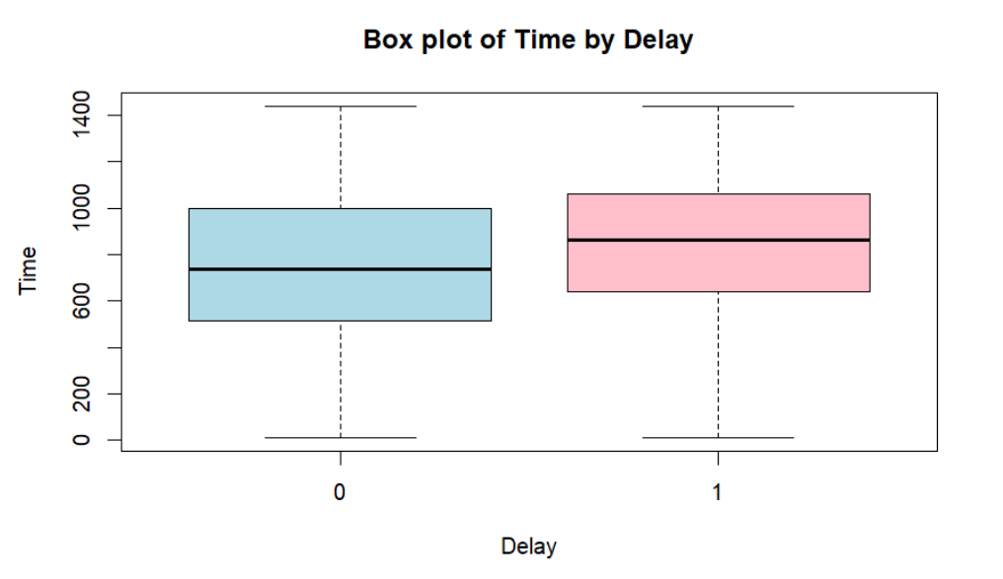
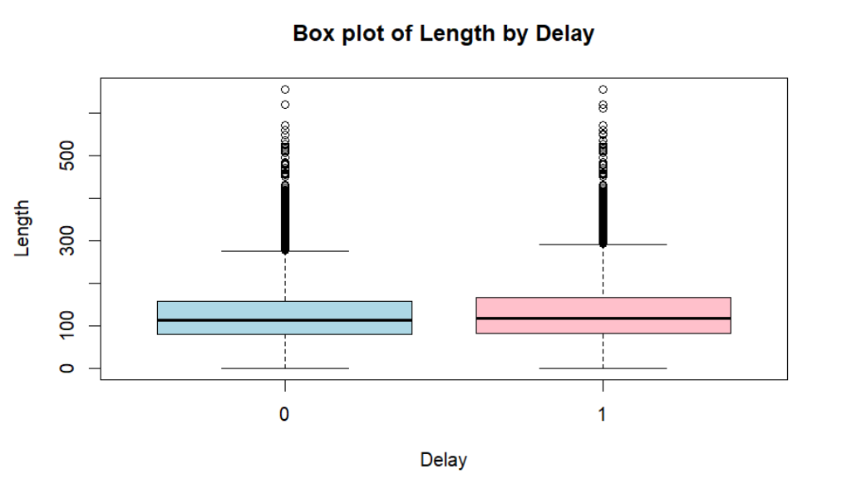
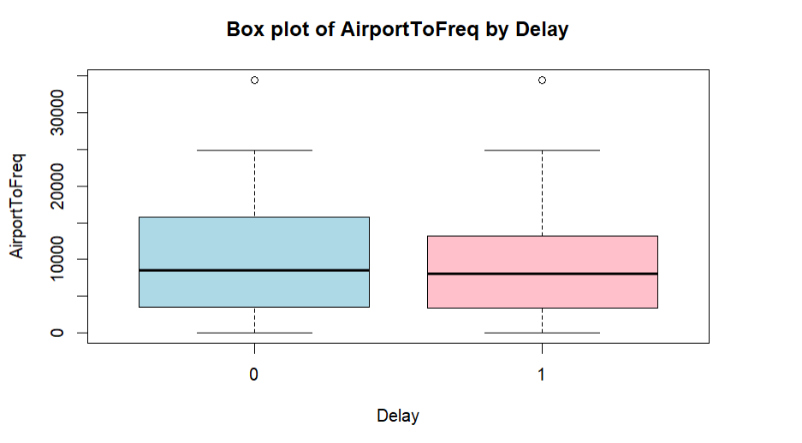
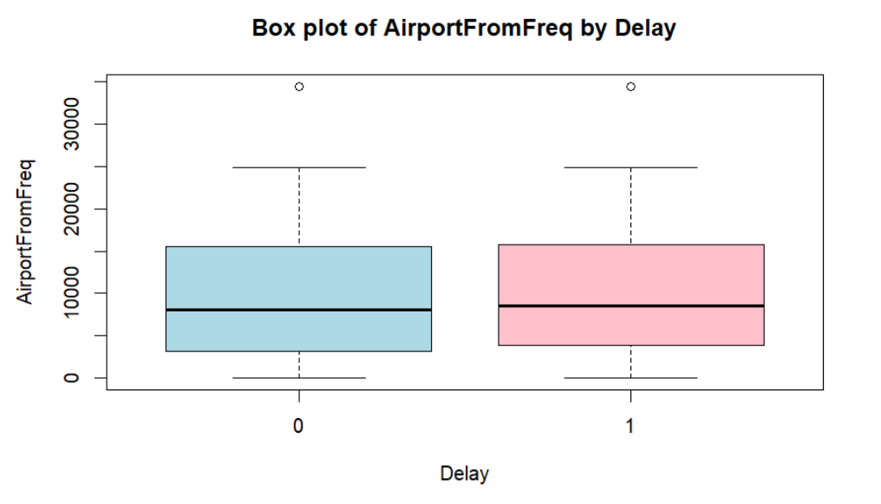
STATISTICAL TESTS AND PLOTS

Slide 25
STATISTICAL TESTS AND PLOTS
Conclusion on the basis of graph:
The mosaic plots compare flight delays (no delay = 0, delay = 1) across different airlines. The larger blue
areas show flights without delays, while the smaller orange areas indicate delayed flights. These plots help
visualize how delays vary for each airline.

Slide 26
STATISTICAL TESTS AND PLOTS
Conclusion on the basis of graph:
Delays are influenced by key factors such as flight time, duration, and airport traffic, with slight variations observed across days of the week and specific airports. Important categorical and numeric variables, excluding `Airline.F9`, show strong associations with delays, making them crucial for further analysis and modeling.

Slide 27
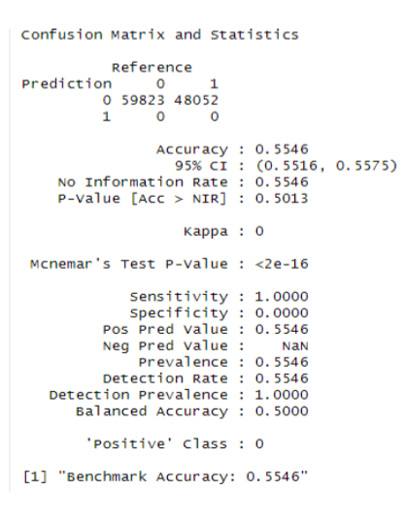
CONFUSION MATRIX AND STATISTICAL ANALYSIS
Summary:
The model shows very serious class imbalance, as it predicts the majority class only, that is, 0, and never the minority
class, 1. While accuracy is decent, it is an optical illusion because the model does not recognize classes. Therefore, the
imbalance should be balanced with oversampling, under sampling, or cost-sensitive learning in order to make a
more successful performance.

Slide 28
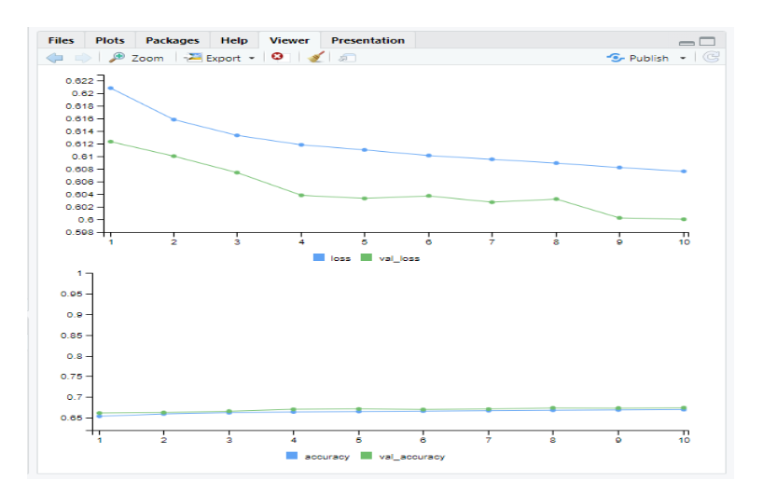
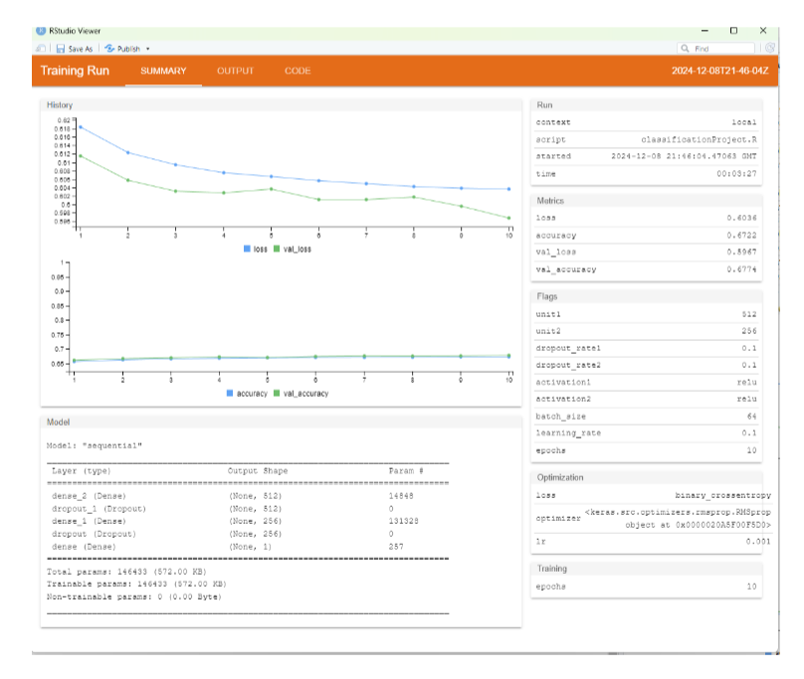
TRAINING PERFORMANCE AND LEARNING CURVES

Slide 29
TRAINING PERFORMANCE AND LEARNING CURVES
Conclusion:
Summary of Model Training:
Performance Metrics:
o Final Training Accuracy: 67.22%
o Final Validation Accuracy: 67.74%
o Final Training Loss: 0.6036
o Final Validation Loss: 0.5967
The learning curves demonstrate consistent improvement in both training and validation performance, with
no significant divergence, highlighting effective training.

Slide 30
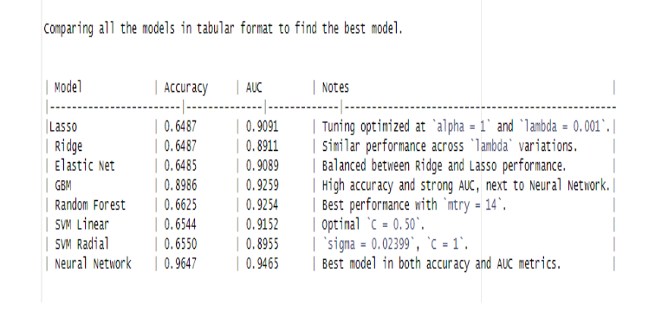
COMPARITIVE EVALUATION OF ML MODELS

Slide 31
COMPARITIVE EVALUATION OF ML MODELS
Conclusion:
The evaluation highlights the Neural Network as the best model for predicting flight delays, given its superior
performance across both accuracy and AUC metrics. GBM and Random Forest also exhibit strong predictive
capabilities and can be considered reliable alternatives. For simpler, interpretable models, Lasso and Elastic Net
provide reasonable trade-offs.

Slide 32
CONCLUSION
The project highlights the potential of machine learning and data analytics in solving real-world problems like flight delays. Future enhancements could include:
• Incorporating additional features, such as weather conditions and air traffic data.
• Exploring ensemble models to further improve performance.
• Deploying the model into a real-time system for dynamic prediction and decision-making.
This project serves as a strong example of applying data-driven approaches to enhance operational efficiency and customer satisfaction in the aviation industry.

Slide 33
RECOMMENDATIONS
• Enhance prediction accuracy by incorporating additional features such as weather, air traffic, and passenger data, along with real-time data integration.
• Optimize model performance using advanced techniques like ensemble models, feature selection, and extended hyperparameter tuning.
• Deploy the model on cloud platforms and integrate APIs to enable real-time predictions and operational planning.
• Create interactive dashboards and automated reports to provide actionable insights for stakeholders.
• Explore advanced research areas such as causal analysis, explainable AI (XAI), and transfer learning to improve model utility and adaptability.

Slide 34
FUTURE WORK AND REFERENCES
Incorporate Additional Features: Include external data such as weather conditions, air traffic patterns, and passenger volumes to enhance predictive accuracy.
Advanced Model Techniques: Explore ensemble methods and neural architecture search for improved model performance and robustness.
Real-Time Deployment: Implement the model in a real-time prediction system integrated with airline operations to support proactive decision-making.
Explainability and Usability: Leverage explainable AI (XAI) methods to make predictions more interpretable and actionable for stakeholders.

Slide 35
FUTURE WORK AND REFERENCES
Incorporate Additional Features: Include external data such as weather conditions, air traffic patterns, and passenger volumes to enhance predictive accuracy.
Advanced Model Techniques: Explore ensemble methods and neural architecture search for improved model performance and robustness.
Real-Time Deployment: Implement the model in a real-time prediction system integrated with airline operations to support proactive decision-making.
Explainability and Usability: Leverage explainable AI (XAI) methods to make predictions more interpretable and actionable for stakeholders.
References:
https://www.kaggle.com/datasets/jimschacko/airlines-dataset-to-predict-a-delay

